Slide 1
IronHack Payments
Katja Kuznetsova & Jonathan Sada

Slide 2
Objectives:
“Analyze user cohorts defined by the month of creation of their first cash advance.”
“Calculate Frequency of Service Usage, Incident Rate and Revenue Generated by the Cohort”

Slide 3
Exploratory Analysis

Slide 4
Requests Analysis
How to identify the requests that were paid?
First Assumption:
We can use certain values of the column "status" ("money_sent", "active", "money_back", ...) to identify requests that received money
Final Assumption:
Filter the paid request by the ones that have the value 'send_at' defined, since it represent the date when the money was sent.

Slide 5
Requests Analysis
Feature Analysis:
After reviewing the non numerical values we have confirmed that the categorical values are:
status
transfer_type
recovery_status
We did not find values in these categories mistyped or outside of the ones described at the documentation
The analysis of the numerical values did not provide much relevant information:
In general the distribution of the amount is in between 0 and 100 but there are some cases that it can be 200.
We confirmed all user_id with value NULL have a deleted_account_id, so these where deleted due GDPR.
The other numerical values where ids so the distribution or its statistical values where not relevant.

Slide 6
Requests Analysis
Assumptions*:
We decided to leave outside the request with these characteristics based on our assumptions:
Status = "canceled": This only represents 33 requests in all the dataset (close to 0%)
Status ="transaction_declined": Payment was not done yet but money_sent date is set.
It also represents less than the 0% of the transactions (48 in total)
'deleted_account_id' != Null: Unclear if we can use their data (due GDPR) (plus makes easier to group the data).
Assumptions we rejected:
“We can safely delete request with status=rejected".
We have checked the amount of rejected request that where paid and these represents the 23% of all paid requests (3862/16641) so we will not delete them.
* We would need to validate if these are relevant or not with a business person.

Slide 7
Fees Analysis:
Feature Analysis:
Analysing the empty values we have discover:
categories has 18865/21061 empty.
Based on the lexicary description we can understand that only fees with incidents have this value set.
paid_at has 5530 empty fields.
Assumption: these are payments still pending to be paid
from_date and to_date have 13295 empty fields.
Based on the lexicarium these are only applied to postponed fees.
On the numeric side we have found:
All the amounts are equal to 5 except for 1 that was 10.

Slide 8
Fees Analysis
Assumptions*:
We decided to filter the payments as “paid” based on these assumptions:
Since type = "incident" represents a payment fee due a reimbursement and not an incident with a payments we can’t use it to identify the payments with incidents
We can use Category == NaN to determine if a payments had an incident or not.
We can use paid_at to determine the date of payment for each feed except for the payments with type=postponed. On these cases we will take the date in to_date as payment date
* We would need to validate if these are relevant or not with a business person.

Slide 9
Cohorts identified

Slide 10
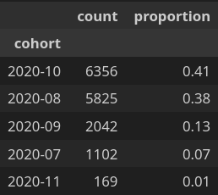
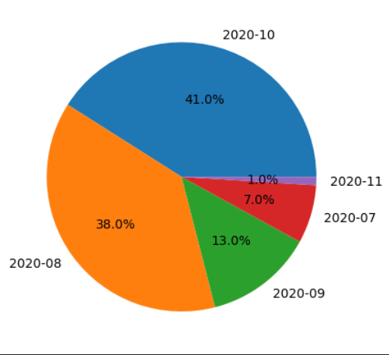
Cohorts Identified
Based on the assumptions described in the analysis we have categorize the students on these cohorts:
‘2020-07’, ‘2020-08’, ‘2020-09’, ‘2020-10’, ‘2020-11’
# of requests per cohort

Slide 11
Metrics

Slide 12
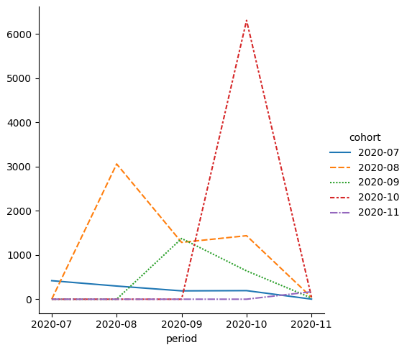
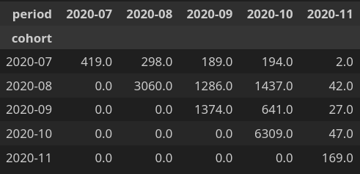
Frequency of Service Usage
Count of request in each cohort per period of time (Months)

Slide 13
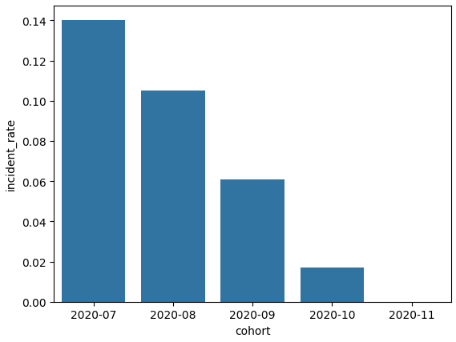
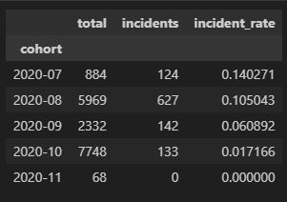
Incident Rate
Rate calculated based on the number of payments with incidents and the total amount of payments
(for the request filtered previously)

Slide 14
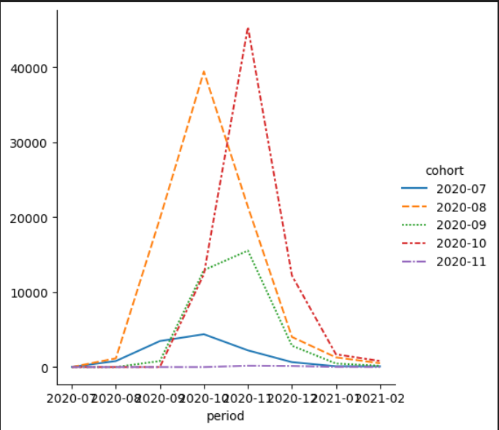
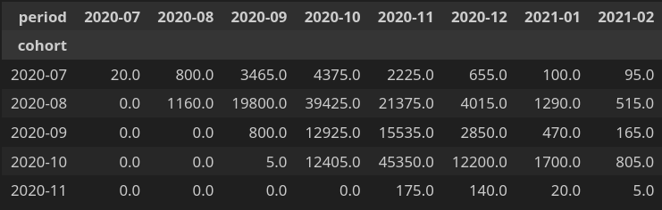
Revenue Generated by the Cohort
Total amount of money brought by IronHack based on the payments for the requests in each cohort.

Slide 15
Revenue Generated by the Cohort
Total amount of money brought by IronHack based on the payments for the requests in each cohort.

Slide 16
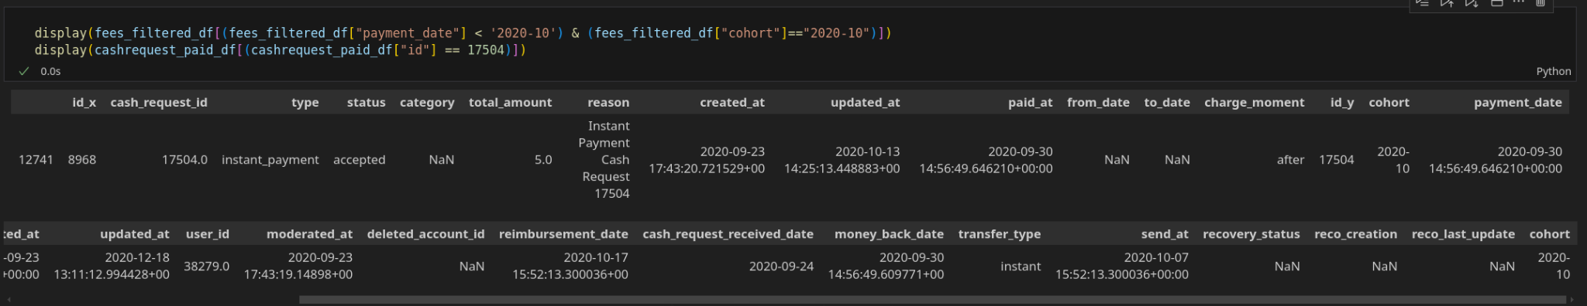
Revenue Generated by the Cohort
Total amount of money brought by IronHack based on the payments for the requests in each cohort.
Based on our assumptions this shows that the money was sent before the request was paid.
This could be showing:
An error in our assumptions
An error in the data
Given it is only one case in the full dataset we decided to ignore it by now (a deeper analysis is required)

Slide 17
Challenges & Learnings

Slide 18
Frequency of Service Usage
Challenges:
The base of our calculation - when the payment was created or send to the users
The moment we change our assumptions we had to correct our analysis and further steps
Learnings:
DataFrame.transform() method

Slide 19
Thank you

